Slide 1
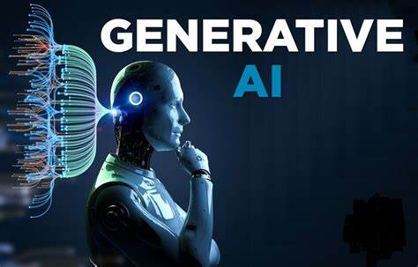
SIGN LANGUAGE DETECTION
Presented by
Praveen Kumar P
613521104028
NM id:47E0942E0CF6D5EBDF44D73899E5C95E

Slide 2
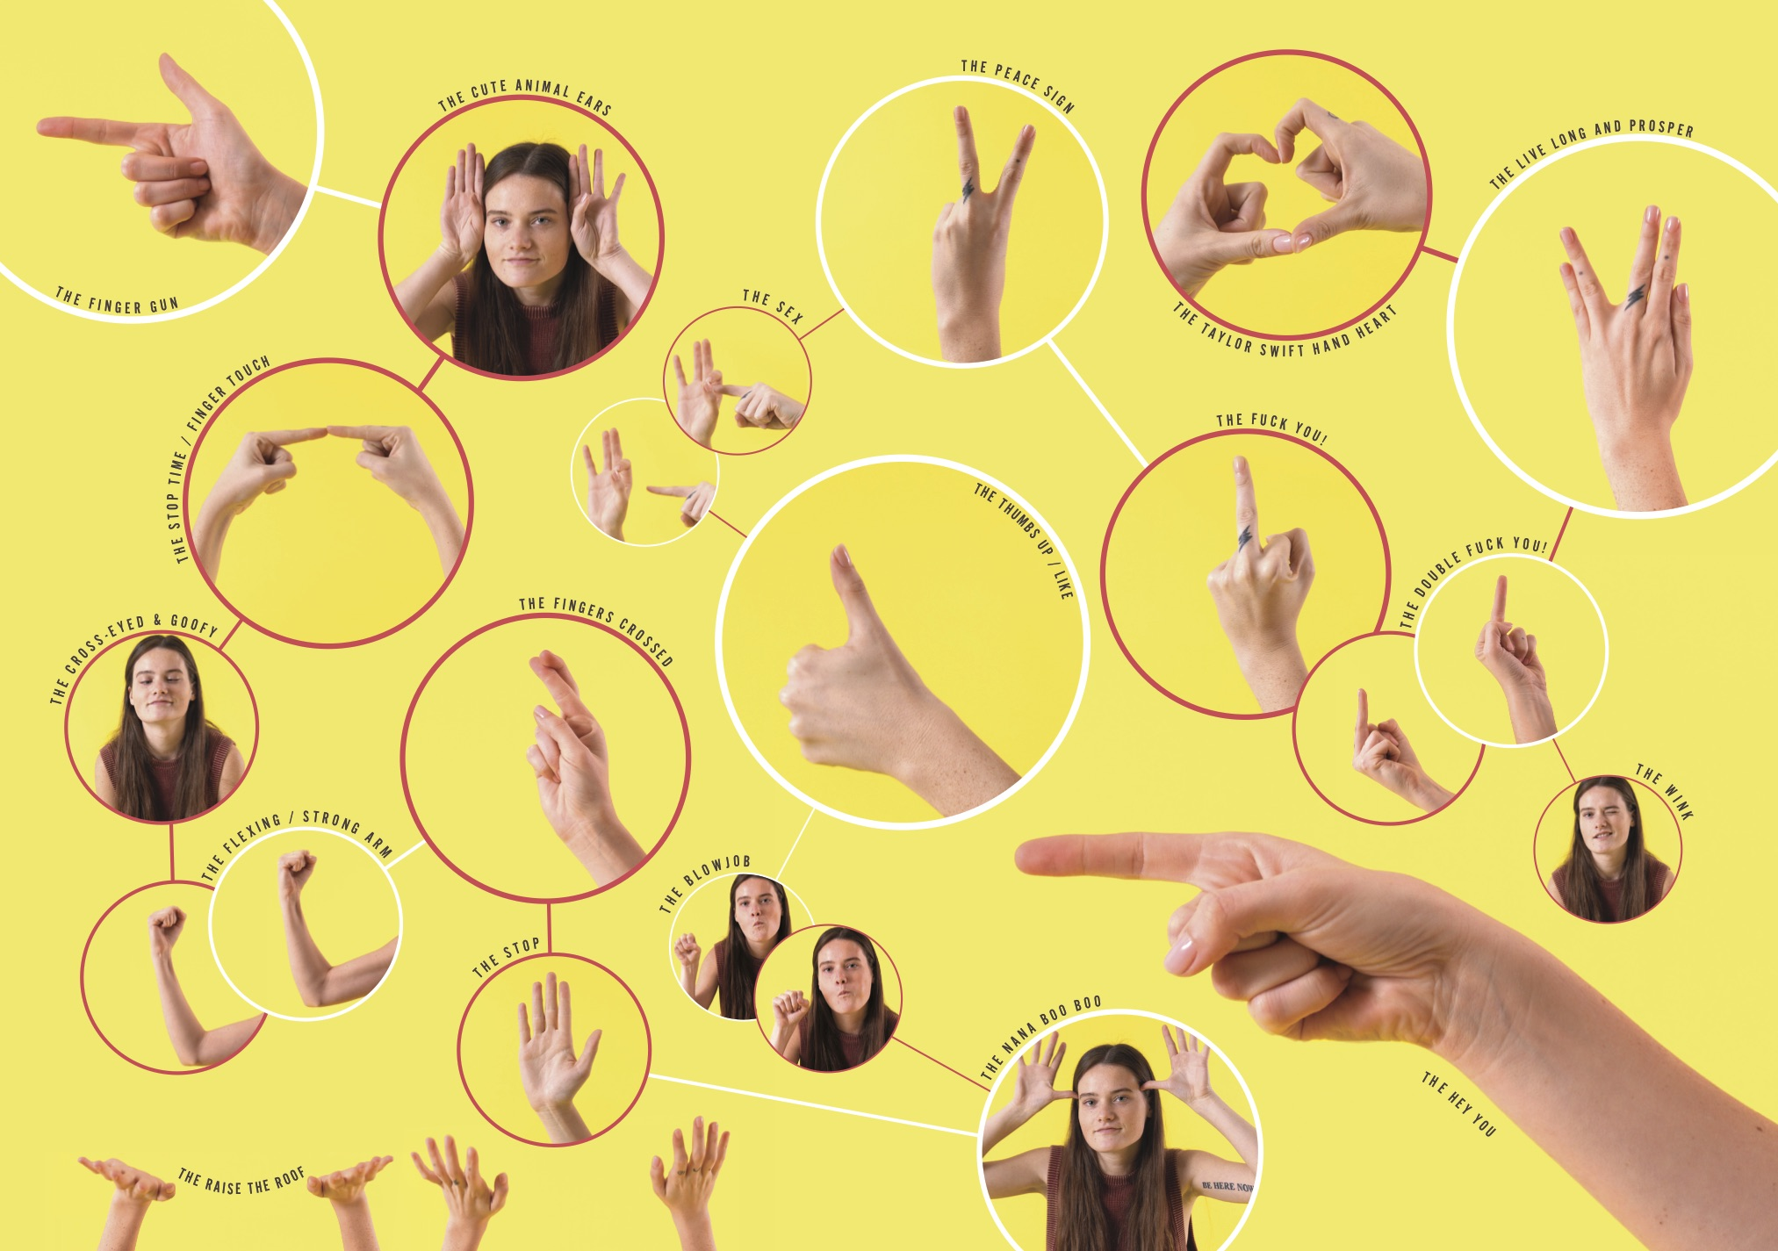
Introduction
Sign language detection involves the recognition and interpretation of hand gestures and movements to translate them into corresponding textual or spoken language, facilitating communication for individuals with hearing impairments. Using computer vision and machine learning techniques, sign language detection systems aim to bridge the communication gap between sign language users and non-signers.

Slide 3

CODE PART
Data Collection
Test Data Collection
Resize Image
Create Model
Predict the output

Slide 4
Importing Packages
Cvzone and cv2
Mediapipe
Tensorflow (keras api)
Numpy
Math

Slide 5
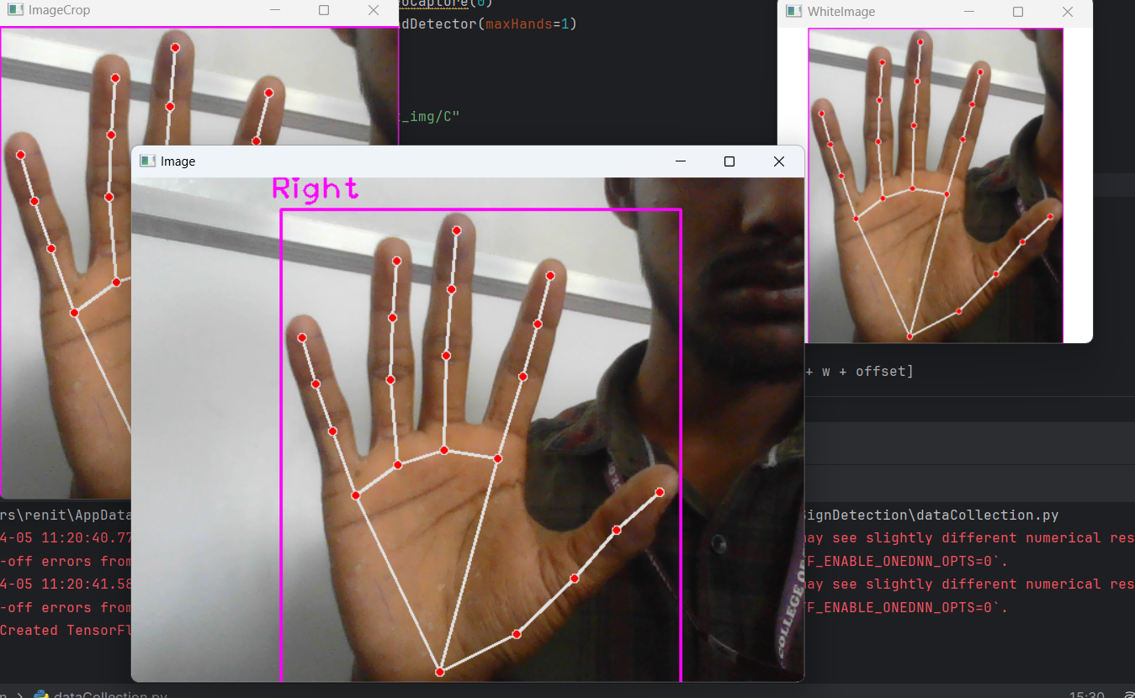
Data Collections
Here, we are not using any pre-existing dataset; instead, we are creating our own dataset. We will classify it into three categories: A, B, and C.
We use the webcam to collect the images and save as the classes of images

Slide 6
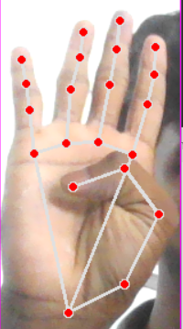
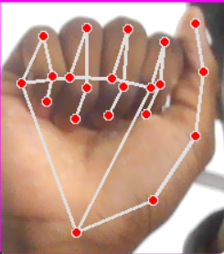
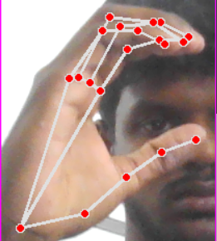
Data Categorized
Collect for train the data ,use the webcam to elaborate the process of Train
A
C
B

Slide 7
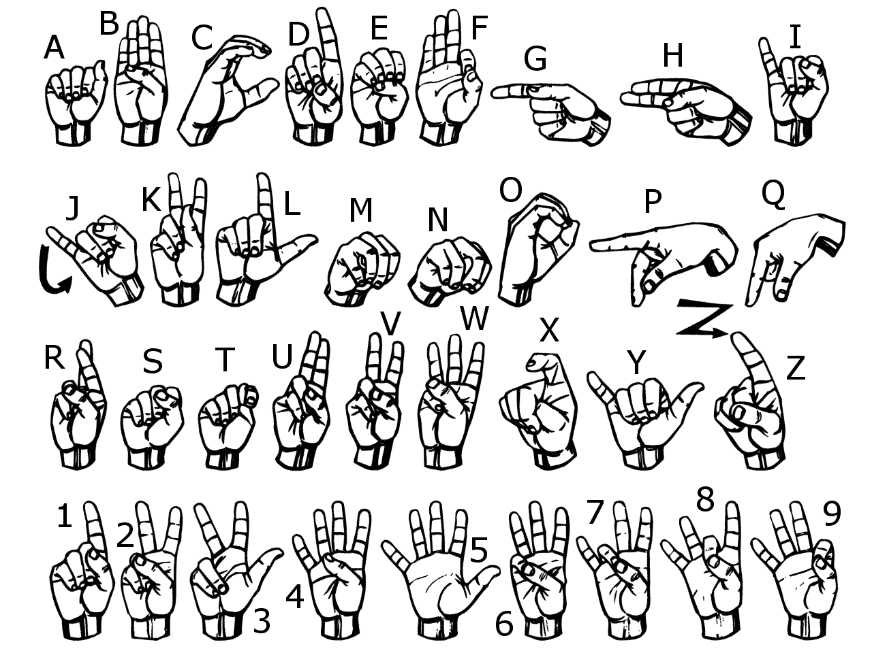
Data Categorized
Here, we use American Sign Language to train the model. If you want to add more symbolic signs, you can do so.

Slide 8
Data Categorized
Here, we use American Sign Language to train the model. If you want to add more symbolic signs, you can do so.
The model is defined as a sequential stack of layers.
It consists of three convolutional layers with ReLU activation followed by max-pooling layers.
The output from the convolutional layers is flattened and fed into two fully connected (Dense) layers with ReLU activation.
The output layer has softmax activation with the number of units equal to the number of classes in the dataset.

Slide 9
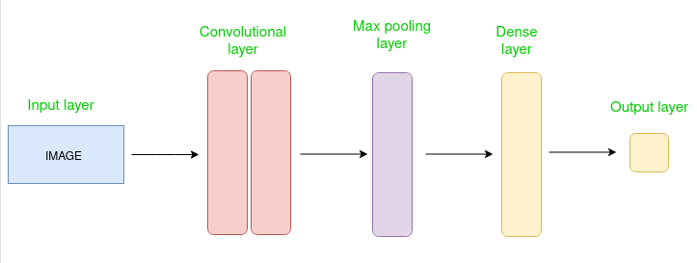
Convolutional Neural Network

Slide 10
CNN in our project
Output
Input layer
Convolutional
Max Pooling
Flatten

Slide 11
Thank You

